Slide 1
College Tech Math 1A
Sections 13.3
Factoring General Polynomials

Slide 2





Factoring Polynomials
Trinomials with a leading coefficient of 1.
$$x^{2}+bx+c=(x + x_{1 })(x + x_{2 })$$
$$binomial 1$$
$$binomial 1$$
$$x_{1}∙x_{2}=c$$
$$x_{1}+x_{2}=b$$
$$x^{2}+9x+20=( x + 4 )( x + 5 )$$
$$4∙5=20 4+5=9$$

Slide 3

Factoring Polynomials
Trinomials with a leading coefficient of 1.
$$x^{2}−bx+c=(x − x_{1 })(x − x_{2 })$$
$$binomial 1$$
$$binomial 1$$
$$x_{1}∙x_{2}=c$$
$$x_{1}+x_{2}=−b$$
$$x^{2}−6x+8=( x − 4 )( x − 2 )$$
$$−4∙\left(−2\right)=8 −4+\left(−2\right)=−6$$

Slide 4



Factoring Polynomials
Trinomials with a leading coefficient of 1.
$$x^{2}−bx−c=(x − x_{1 })(x + x_{2 })$$
$$binomial 1$$
$$binomial 1$$
$$x_{1}∙x_{2}=c$$
$$x_{1}+x_{2}=−b$$
$$\left|x_{1}\right|>\left|x_{2}\right|$$
$$x^{2}−3x−10=( x − 5 )( x+ 2 )$$
$$−5∙\left(2\right)=−10 −5+2=−3$$

Slide 5

Factoring Polynomials
Trinomials with a leading coefficient of 1.
$$x^{2}+bx−c=(x + x_{1 })(x − x_{2 })$$
$$binomial 1$$
$$binomial 1$$
$$x_{1}∙x_{2}=c$$
$$x_{1}+x_{2}=−b$$
$$\left|x_{1}\right|>\left|x_{2}\right|$$
$$x^{2}+2x−8=( x + 4 )( x − 2 )$$
$$4∙\left(−2\right)=−8 4+\left(−2\right)=2$$

Slide 6









Factoring Polynomials
Factor each polynomial completely. (Example)
$$f) x^{2}+12x+20$$
Trinomial – look for GCF
$$GCF=1$$
$$(x )(x )$$
$$+10$$
$$+2$$
$$10∙2=20$$
$$x_{1}∙x_{2}=20$$
$$x_{1}+x_{2}=12$$
$$10+2=12$$

Slide 7








Factoring Polynomials
Factor each polynomial completely. (Example)
$$g) x^{2}−4x+3$$
Trinomial – look for GCF
$$GCF=1$$
$$(x )(x )$$
$$−3$$
$$−1$$
$$(−3)∙(−1)=3$$
$$x_{1}∙x_{2}=3$$
$$x_{1}+x_{2}=−4$$
$$−3+\left(−1\right)=−4$$

Slide 8







Factoring Polynomials
Factor each polynomial completely. (Example)
$$h) x^{2}−7x−8$$
Trinomial – look for GCF
$$GCF=1$$
$$(x )(x )$$
$$−8$$
$$+1$$
$$\left(−8\right)∙1=−8$$
$$x_{1}∙x_{2}=−8$$
$$x_{1}+x_{2}=−7$$
$$−8+1=−7$$

Slide 9










Factoring Polynomials
Factor each polynomial completely. (Example)
$$i) {3x}^{2}+3x−18$$
Trinomial – look for GCF
$$GCF=3$$
$$3(x^{2}+x−6)$$
$$x_{1}∙x_{2}=−6$$
$$\left(−2\right)∙3=−6$$
$$3(x )(x )$$
$$−2$$
$$+3$$
$$x_{1}+x_{2}=1$$
$$−2+3=1$$

Slide 10
Factoring Polynomials
Factor each polynomial completely. (Skill Check)
$$e) x^{2}+7x+10 =(x+5)(x+2)$$
$$f) x^{2}−6x+8 =(x−4)(x−2)$$

Slide 11
Factoring Polynomials
Factor each polynomial completely. (Skill Check)
$$i) 5x^{2}−15x−20 =5(x−4)(x+1)$$

Slide 12






Factoring Polynomials
Quadrinomials are factoring using grouping.
$$ax^{2}+bx+cx+d$$
$$=a\left(binomial\right)+b(binomial)$$
$$GCF$$
$$GCF$$
$$binomial GCF$$
$$=(binomial)(a+b)$$

Slide 13










Factoring Polynomials
Factor each quadrinomial using grouping. (Example)
$$a) 4x^{2}+8x+3x+6$$
Factor out the GCF of group 1
Group 1
Group 2
Factor out the GCF of group 2
$$4x( )$$
$$x$$
$$+2$$
$$+3( )$$
$$x$$
$$+2$$
Binomial – look for GCF
$$GCF=(x+2)$$
$$(x+2)( )$$
$$4x$$
$$+3$$

Slide 14









Factoring Polynomials
Factor each quadrinomial using grouping. (Example)
$$b) 5x^{2}−20x−2x+8$$
Factor out the GCF of group 1
Group 1
Group 2
Factor out the GCF of group 2
$$5x( )$$
$$x$$
$$−4$$
$$−2( )$$
$$x$$
$$−4$$
Binomial – look for GCF
$$GCF=(x−4)$$
$$(x−4)( )$$
$$5x$$
$$−2$$

Slide 15
Factoring Polynomials
Factor each quadrinomial using grouping. (Skill Check)
$$a) 2x^{2}+12x+5x+30 =(x+6)(2x+5)$$
$$b) 4x^{2}+4x−3x−3 =(x+1)(4x−3)$$

Slide 16
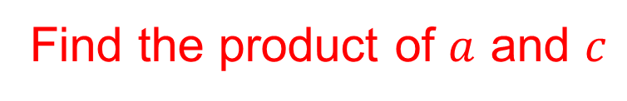


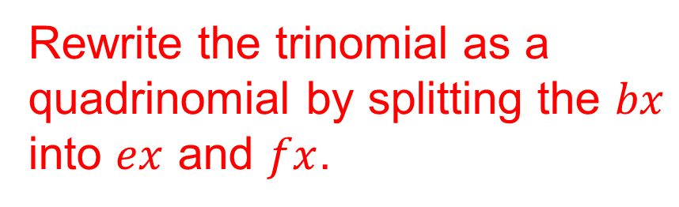
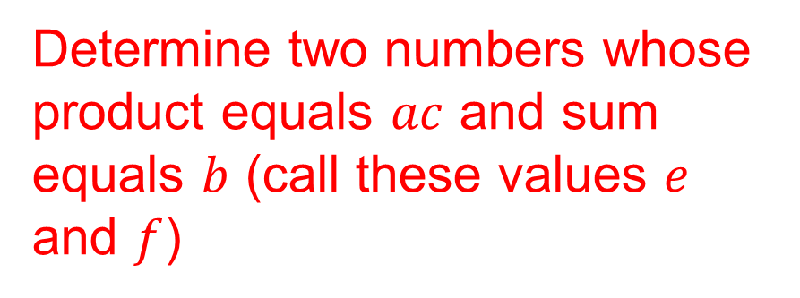
Factoring Polynomials
Trinomials can be factored using the grouping technique. This requires rewriting the trinomial as a quadrinomial.
$$ax^{2}+bx+c$$
Find the product of $a$ and $c$
Determine two numbers whose product equals $ac$ and sum equals $b$ (call these values $e$ and $f$)
$$ax^{2}+ex+fx+c$$
Rewrite the trinomial as a quadrinomial by splitting the $bx$ into $ex$ and $fx$.

Slide 17



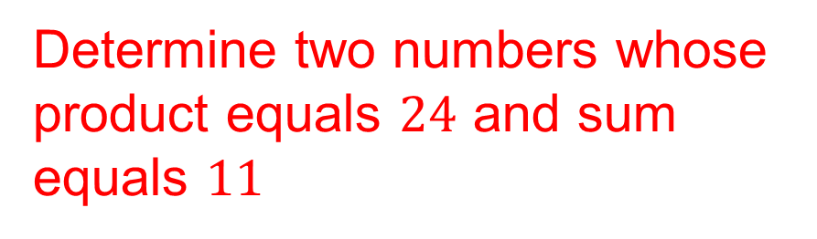

Factoring Polynomials
Factor each trinomial using grouping. (Example)
$$a) 2x^{2}+11x+12$$
Find the product of $a$ and $c$
$$2\left(12\right)=24$$
Determine two numbers whose product equals $24$ and sum equals $11$
$$8\left(3\right)=24 8+3=11$$

Slide 18





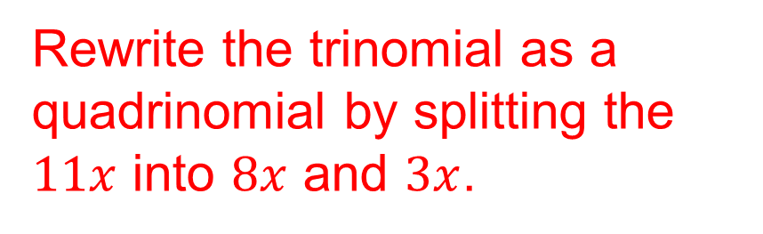

Factoring Polynomials
Factor each trinomial using grouping. (Example)
$$a) 2x^{2}+11x+12$$
$$8\left(3\right)=24 8+3=11$$
Rewrite the trinomial as a quadrinomial by splitting the $11x$ into $8x$ and $3x$.
$$2x^{2}+8x+3x+12$$
$$2x^{2}+8x+3x+12$$
$$2x(x+4)$$
$$+3(x+4)$$
Factor using grouping
$$(x+4)(2x+3)$$

Slide 19

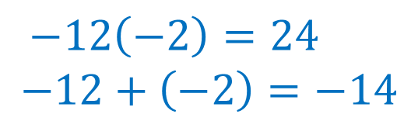


Factoring Polynomials
Factor each trinomial using grouping. (Example)
$$a) 3x^{2}−14x+8$$
Find the product of $a$ and $c$
$$3\left(8\right)=24$$
Determine two numbers whose product equals $24$ and sum equals $−14$
$$−12\left(−2\right)=24$$
$$−12+\left(−2\right)=−14$$

Slide 20

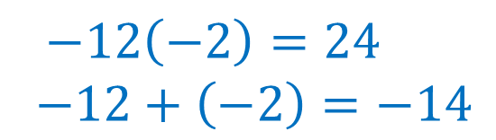




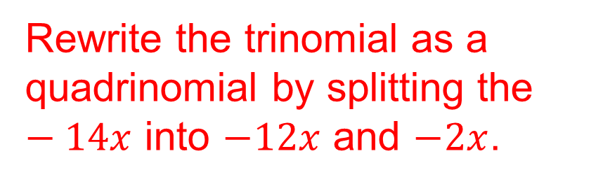

Factoring Polynomials
Factor each trinomial using grouping. (Example)
$$b) 3x^{2}−14x+8$$
$$−12\left(−2\right)=24$$
$$−12+\left(−2\right)=−14$$
$$3x^{2}−12x−2x+8$$
Rewrite the trinomial as a quadrinomial by splitting the $−14x$ into $−12x$ and $−2x$.
$$3x^{2}−12x−2x+8$$
$$3x(x−4)$$
$$−2(x−4)$$
Factor using grouping
$$(x−4)(3x−2)$$

Slide 21
Factoring Polynomials
Factor each trinomial using grouping. (Skill Check)
$$a) 2x^{2}+9x+4 =(x+4)(2x+1)$$
$$b) 4x^{2}−11x−3 =(x−3)(4x+1)$$

